Slide 1
JobNexus
By
Akriti Chapagain
Binaya Koirala

Slide 2
Introduction
Job Portal Mobile Application, to be built using React Native
will offer a seamless experience for both job seekers and employers.
With features like categorized job listings including popular and nearby options, as well as job types ranging from part-time to full-time and contract positions, we will ensure a comprehensive job search experience.

Slide 3
2. PROBLEM STATEMENT
Job seekers often struggle to find job opportunities that match their skills and preferences.
Employers face difficulties in attracting qualified candidates for their job vacancies.
Existing job search platforms may lack user-friendly interfaces, comprehensive job listings, or effective recruitment management tools.

Slide 4
3. OBJECTIVES
Provide job seekers with an intuitive platform to register, search, and apply for suitable job opportunities.
Implement features such as categorized job listings and filters for job types (e.g., part-time, full-time).
Enable employers to register and post job vacancies, including options for managing application

Slide 5
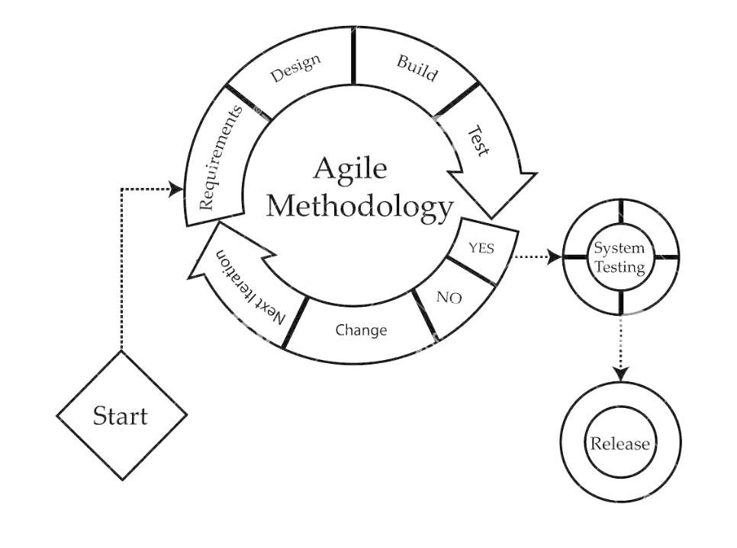
4. METHODOLOGY

Slide 6
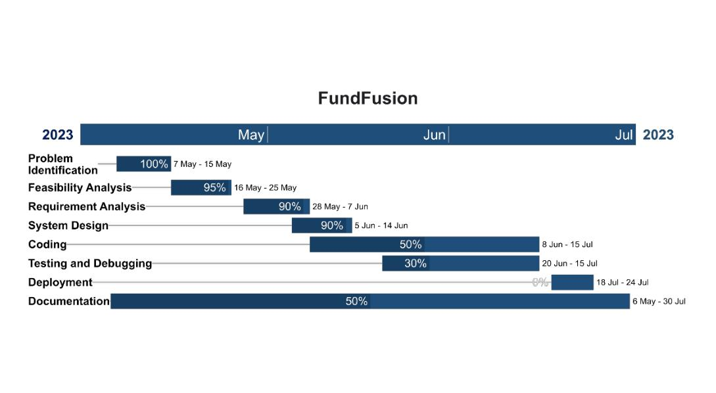
5. GANTT CHART

Slide 7
DELIVERABLES
User registration system allowing job seekers to create accounts and employers to register their companies.
Job search functionality enabling job seekers to browse and search for job listings based on various criteria such as job type, location, and industry.
Resume submission feature allowing job seekers to upload their resumes and apply for job listings directly through the app.
Job posting system allowing employers to create and publish job listings, including options for specifying job details, requirements, and application deadlines.

